Slide 1
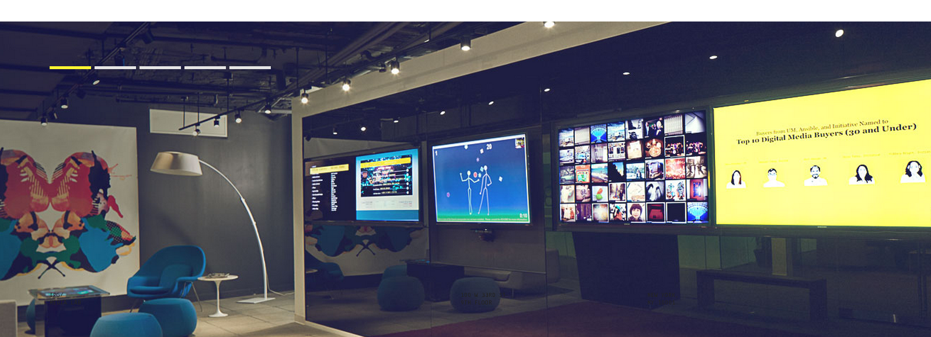

IPG MEDIA LAB 2012 TRENDS /
Notes:
IPG Lab is a physical space based in HQ in NYC entirely dedicated to carefully curated emerging media and technology.

Slide 2
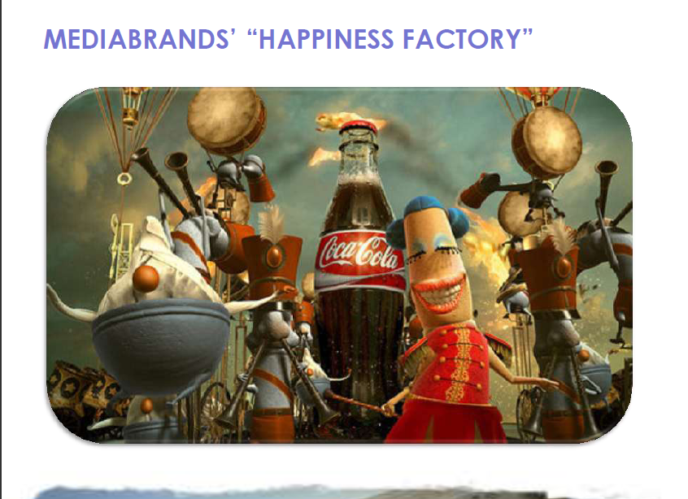
Notes:
The Lab is “physical and metaphorical front door to Mediabrands”….
It is also affectionately regarded as MB’s “happiness factory”.
(We are working with our technology partners to create an experience in the Lab that rewards happiness….)

Slide 3
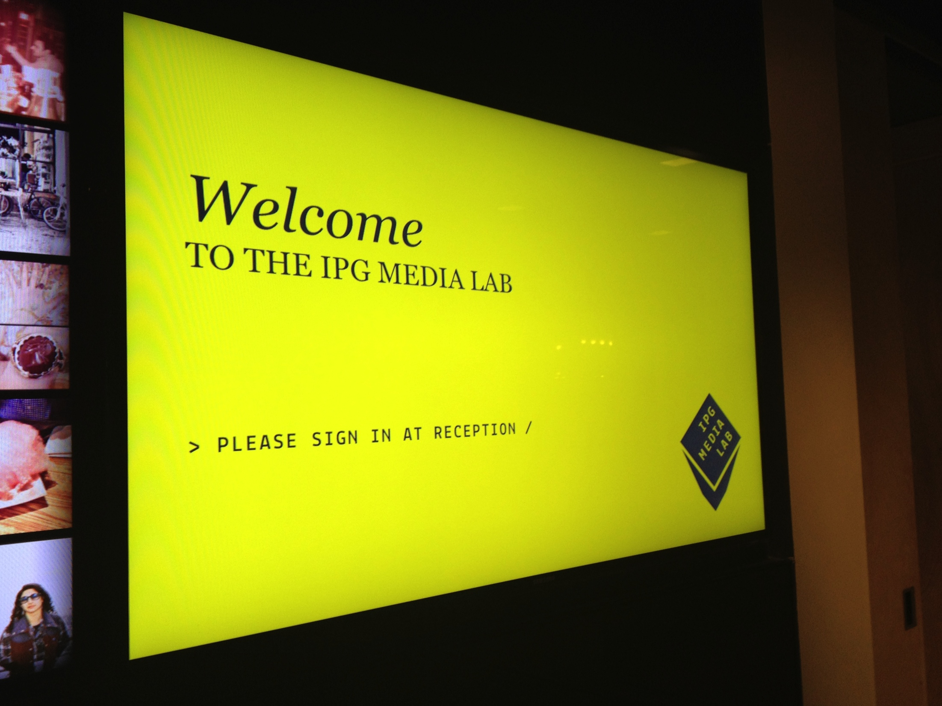
IPG MEDIA LAB /
Lab Days
Virtual Lab
Media Partnerships
Production
Magna Intelligence
Trends

Slide 4
CONTENTS /
VANISHING INTERFACE
DE-OWNERSHIP
BRICK-AND-MORTAR’S DIGITAL LIFE RAFT
CARPE DATA
TECHNO-TOTS

Slide 5
WHERE ARE WE IN 2012? /
We are at an inception point for a shift in computing:
With smartphones, any real world experience can seamlessly become digital
Computing is getting so natural it no longer feels or looks like computing
It is no longer viable to draw a line between physical and digital ecosystem
Notes:
http://www.telegraph.co.uk/technology/news/8848476/Man-gets-smartphone-dock-built-into-prosthetic-arm.html

Slide 6
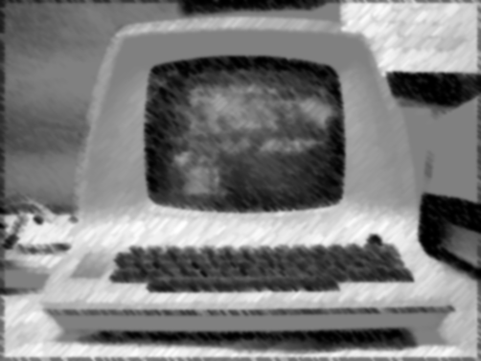
1. VANISHING INTERFACE
Notes:
As computers learn to understand human language and intention as is, the physical components of computing (previously required to translate into computing language) become redundant.
Result is computing seems more natural – not much like computing at all.

Slide 7
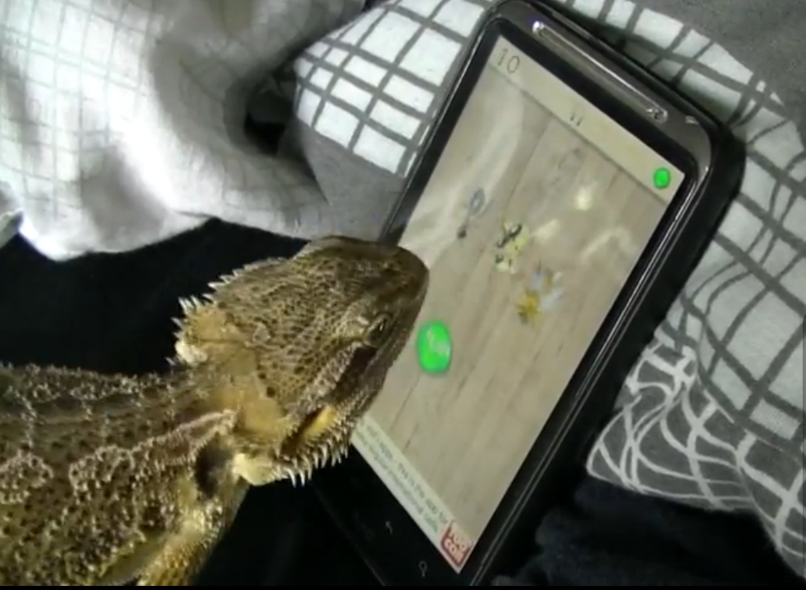
TOUCH COMPUTING IS UBIQUITOUS /
56% will have smartphones
22% will have tablets
(Magnaglobal 2012 forecast)
Notes:
Touch represents an enormous shift towards natural style of computing
Astonishing YouTube videos showing a Bearded Dragon playing Ant Crusher, shows just how natural and intuitive touch computing is
The majority of Americans will carry a touchscreen with them by year’s end.

Slide 8
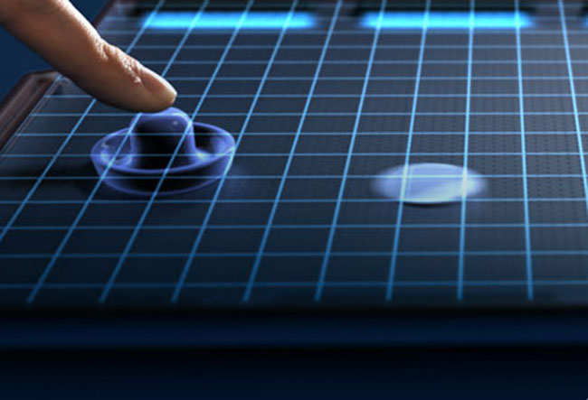
PUTTING FEELING INTO TOUCH /
Tablets to simulate
texture in 2012
Notes:
Through new haptic technology developed by Senseg, touch is getting more real as it will be able to simulate the physical and tactile texture of objects in the real world.
http://www.google.com/url?sa=t&rct=j&q=&esrc=s&source=web&cd=1&ved=0CD0QFjAA&url=http%3A%2F%2Fwww.theverge.com%2F2011%2F12%2F2%2F2605173%2Fsenseg-tactile-display-technology-tablet-demo-video&ei=ZeZHT5RHwo2xArfa6OoI&usg=AFQjCNFD17eKmz4gXJroDeRZ3WvVd8omGQ&sig2=tbBxaR8m0Ff7I52_Tic4TA

Slide 9
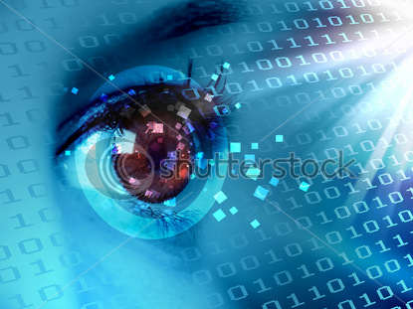
DIGITAL INTERACTION WITH REAL
WORLD TOOLS /
Commercial launch of Kinect for Windows – new wave of natural computing
- no physical interface
Notes:
Arguably more ground-breaking is new wave of and voice computing
enables natural interaction beyond just the fingertips – interact with digital using full range of real world tools.
On Feb 1st, launch of Windows Kinect sensor – the product is not so different from original sensor, though it is a signal of intent.
Kinect will ship with Windows 8 and be synonymous with next wave of computing.

Slide 10

COMPUTING WITH PERSONALITY /
Siri shows promise of computing with personality
Notes:
Siri shows the promise of computing with personality – has a gender, sirisarcasm.com….

Slide 11

2. DE-OWNERSHIP
Notes:
Consumers are letting go of traditional notion of ownership
In media and entertainment consumers are going from owning physical media to digital download, now cloud storage/access is challenging the definition and value of ownership still further. We see two models….

Slide 12

OWNERSHIP GETS REMOTE /
De-Ownership
Diminished ownership rights
Notes:
Remote notion of ownership – diminished version (e.g. Ultraviolet…) though this still banks on consumers still buying DVDs.
http://online.wsj.com/article/SB10001424052970203833004577249652072048154.html?mod=rss_Technology
Walmart to help consumers sign-up/activate UV memberships
Is this a long term solution? Probably not…..

Slide 13
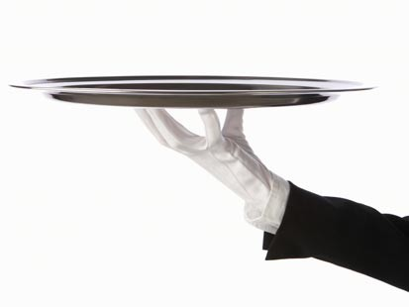
AS-A-SERVICE MODEL HERE TO STAY /
Netflix no. 1 Internet data usage
Kindle Fire revenue from content to grow 173% in 2013
23% of Americans will be active Pandora users 2012
Sources: Sandvine, Barclays Capital, Magnaglobal
Notes:
2. De-ownership as-as-service is a proven model in the home entertainment industry – single-handedly beaten file-sharing.
Amazon revenue growth from Kindle Fire to come from content, not devices (device is pretext for services)
Trend extends to all areas of media – Magnaglobal/Pandora stat.

Slide 14
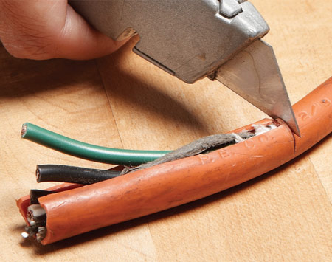
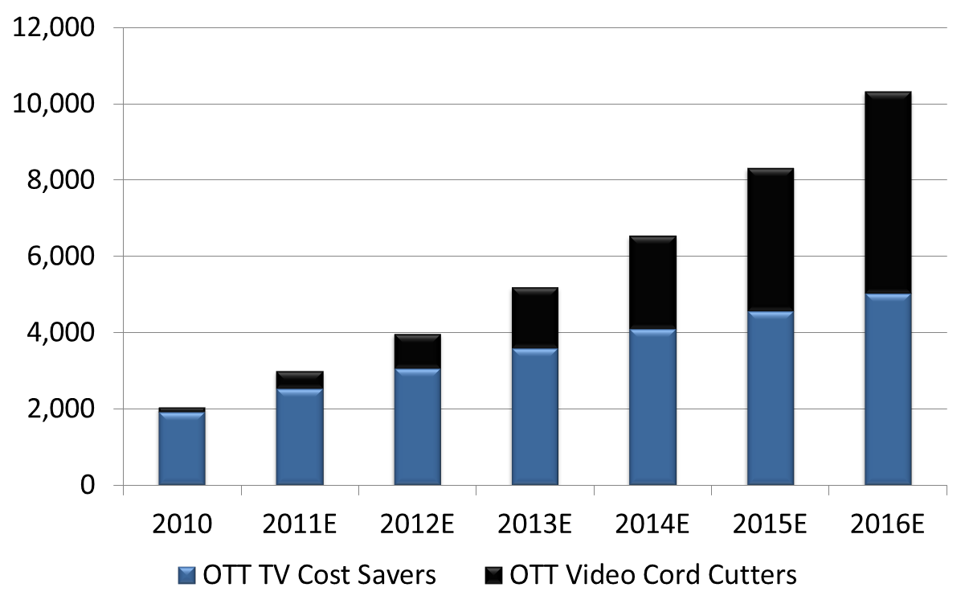
DE-OWNERSHIP MEANS INCREASED RELIANCE ON STREAMING /
By 2016, 9% of homes will rely on streaming; half will have actively “cut the cord” (Magnaglobal)
Cut cable
Never had cable

Slide 15
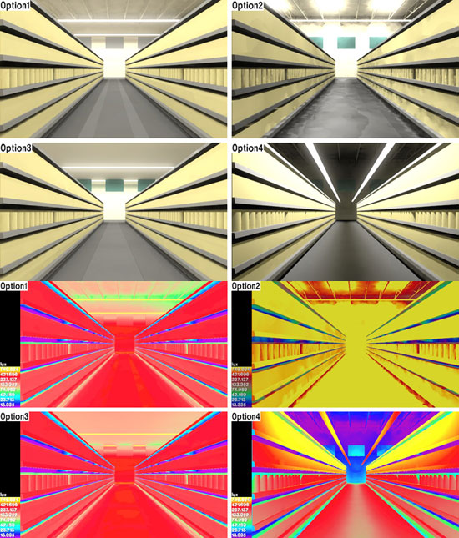
3. BRICK-AND-MORTAR’S DIGITAL LIFE RAFT
Notes:
Euphemistic way of saying the brick-and-mortar retailers are in trouble… though embracing digital could be a life-saver, if taken advantage of properly.

Slide 16

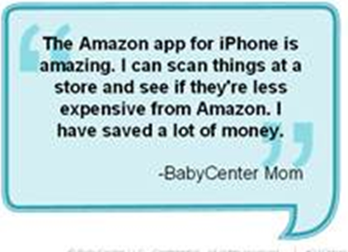
SHOWROOMING /
Consumers are using brick-and-mortar stores as “showrooms”
25% are using phones to compare prices, 13% end up buying elsewhere (Pew)
Notes:
Holiday sales at brick-and-mortar stores grew just 4.1% this year, while online retailing was up 15%
But to make matters worse, online retailers, namely Amazon, is threatening brick-and-mortar sales through price comparison app which more or less guarantees the same product for cheaper price if bought on Amazon.
Consumers are loving this! Especially, highly-prized mum demographic: “amazing”
Pew: 25% of shoppers use their phones to see if they can get a better price elsewhere, and 13% end up purchasing online instead – frightening!

Slide 17
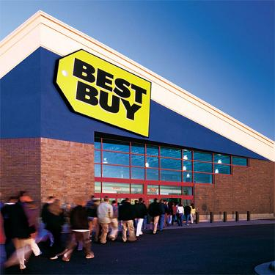
CATCHING UP TO E-COMMERCE /
Best Buy turning “Showrooming” trend to its advantage by embracing physical/digital divide
Notes:
Best Buy is channeling the showrooming trend to ensure that its stores serve as the showroom to its own online store
Done this by niftily changing the barcodes so that scanning leads to Best Buy’s own site
Outmoded to think of brick and mortar and online as having separate bottom line.

Slide 18
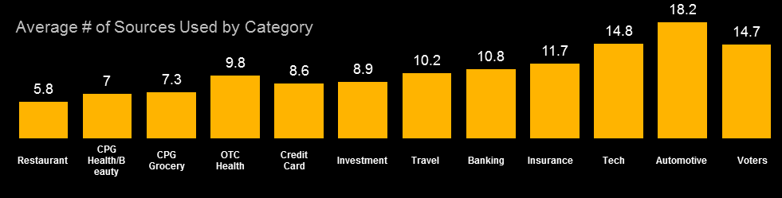
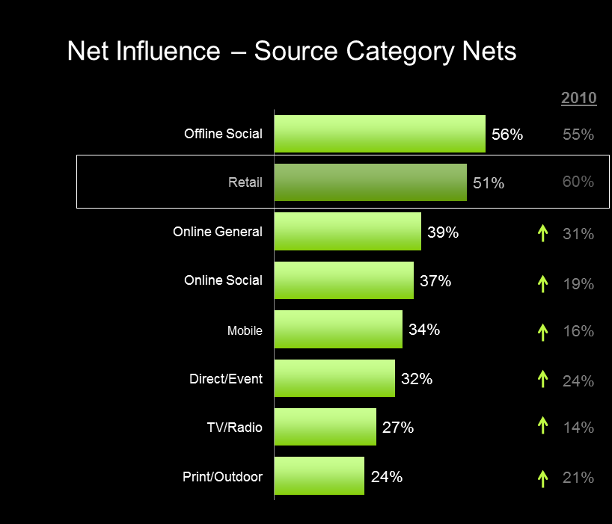
THE REALITY IS MORE NUANCED /
Consumers are checking an average of 10.4 sources to make purchase decisions. (Shopper Sciences)
Physical store is second most important source of influence
(Shopper Sciences)
Notes:
Not linear – checking lots of sources – not thinking in terms of digital and physical
As more info become available, consumers are checking more sources.
Average of 10.4 sources considered in 2011, almost double the number from 2010.

Slide 19

COOKIES FOR THE REAL WORLD /
New tools allow web-like personalization in the store
Notes:
We see a lot of potential in the brick and mortar arena – cookies in the real world are more accurate than cookies at your desktop.
Consumers increasingly relying on mobile devices, which they take everywhere with them in the real world – digital extensions of themselves
At Mediabrands, we talk in terms of one-to-one, one-to-some and one-to-many marketing, with one-to-one being the holy grail.
Opportunity for more precise and timely personalization than ever before, and it lies in when consumers are out and about in the real world.
In the Lab, we have Euclid Elements set up, which literally gives store owners web analytics for their brick-and-mortar store.
Store owners can test tactics and optimize conversion rates as an online retailer can.
Investment in the store environment by third party behemoths like Paypal, Google and the wireless networks ties payments to rewards. In-store
This is something we
THIS WILL ALLOW FOR MORE PERSONALIZATION, BETTER DATA….
GOOGLE EXAMPLE WITH QR CODE
TRUMEDIA –
SAMSUNG TV WITH CAMERA
RHETORIC OF ONE-TO-MANY ETC. – ALLOW OUTSIDE OF ONLINE

Slide 20
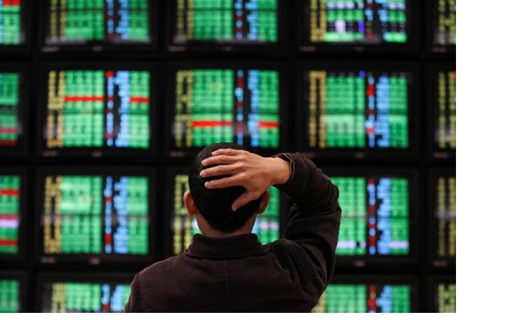
4. CARPE DATA /
Notes:
“Data saves the day”
This is our way of saying how important and powerful data has become and to highlight a few ways that it is touching consumers

Slide 21

DATA NEEDS TO KNOW ITS OWN STRENGTH /
“How could they get their advertisements into expectant mothers’ hands without making it appear they were spying on them? How do you take advantage of someone’s habits without letting them know you’re studying their lives?”
-- Andrew Pole, Target
Guest Marketing Analyst
Notes:
Data, when channeled appropriately, has become suddenly got so sophisticated that it doesn’t know it’s own strength.
As this incident from Target shows, that got coverage on the Colbert Show last week, shows that data is so knowing that it is capable of causing a massive faux pas.
Target’s predictive analytics knows a girl better than her own father, to the point that it outed her pregnancy.
In the new era of data the goal is to learn manners, get subtle, and not come out all guns blazing.
“how could they get their advertisements into expectant mothers’ hands without making it appear they were spying on them? How do you take advantage of someone’s habits without letting them know you’re studying their lives?”
E.G. AS REPORTED ON COLBERT SHOW, TARGET KNEW ABOUT TEENAGE PREGNANCY BEFORE FATHER DID - OUTED PREGNANCY
http://www.rawstory.com/rs/2012/02/23/colbert-target-knows-what-youre-doing-in-bed/
http://www.nytimes.com/2012/02/19/magazine/shopping-habits.html?pagewanted=all

Slide 22
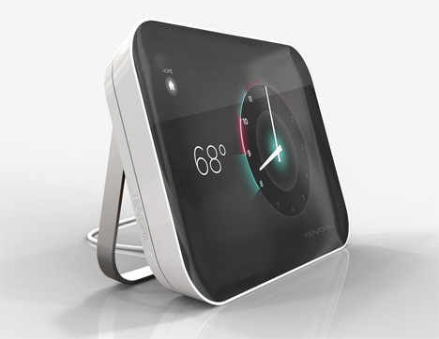
HARDWARE COMPANIES BECOMING DATA COMPANIES /
Siemens invested in cloud-based energy platform, Tendril, for promise of a “new generation of products, applications and devices.”
Notes:
Hardware companies recognizing the value in data
Companies will look to how to monetize that data – more utility-based marketing – here’s a new AC unit that will help you cut your energy bill back by 10% etc.
50% of US will have smart meters in 2016 (Berg)
Siemens' primary interest is in software and services, because
Promise of new gen of products/services/devices
the market's future is in finding ways to monetize big data.
Imagine going online through a
utility's web portal to see a detailed analysis of your electricity bill, only to see an
advertisement for a co-branded utility or AC unit and detailed analytics on the impact of
the new product on your energy bill. Or an EV ad with figures on the trade-off between
charging costs versus gasoline costs. Greater access to information on our electricity use
would impact our buying decisions

Slide 23
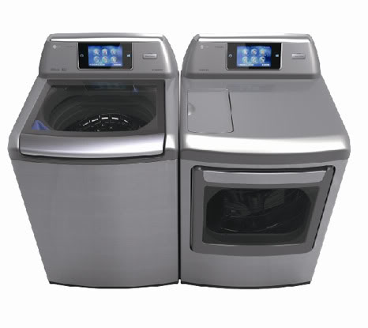
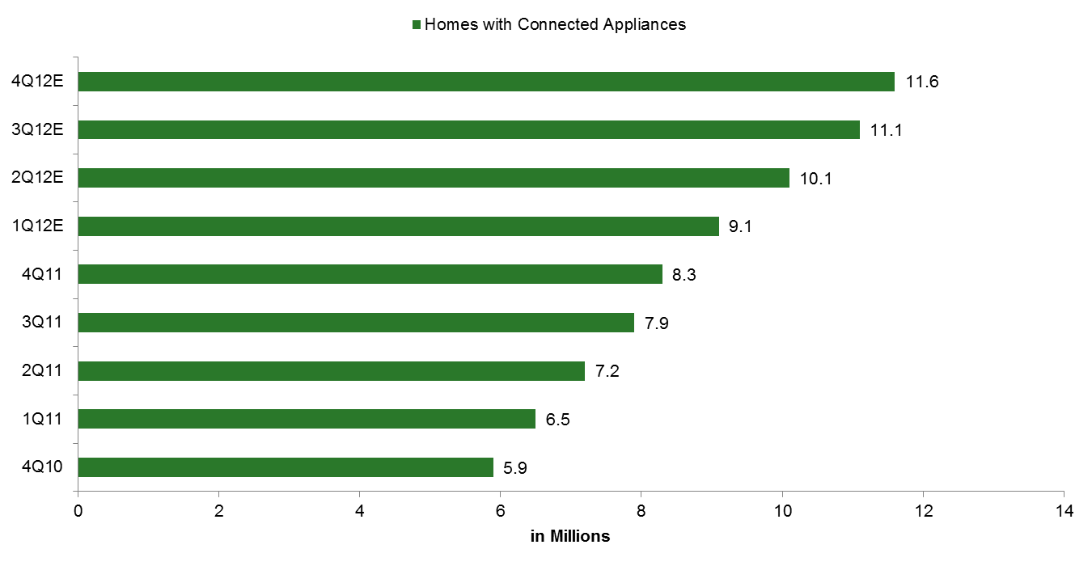
DATA IS BULLET POINT WHEN BUYING PRODUCT/
60% of connected devices at CES were non-traditional.
By the end of the year, 11.6M homes will have connected appliances (Magnaglobal).
Notes:
Over half of all devices at CES were Internet connected.
60% were non-traditional computing devices: TVs, cars, refrigerators and washing machines (GSMA)
Data is now a serious bullet point when selecting a device

Slide 24
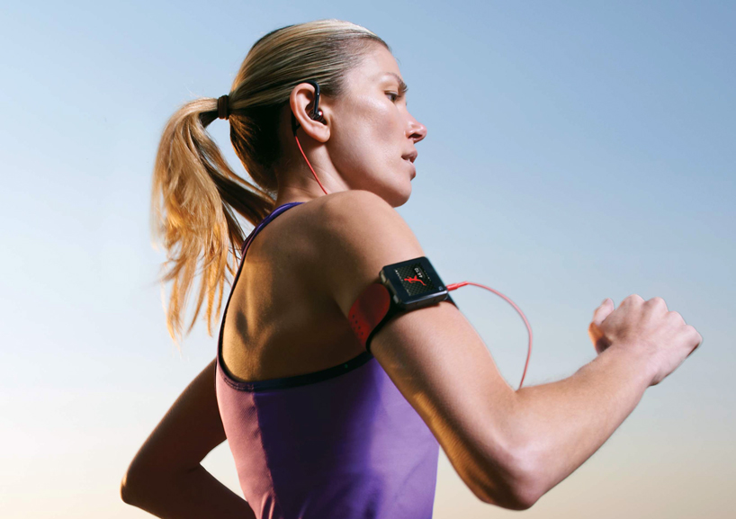
THE SMARTER EVERYDAY /
Notes:
Wearable devices are adding value to activities that consumers are doing everyday.
Provides valuable insights into daily habits = MotoActv takes fitness data and music listening to provide insight into what music you run fastest to

Slide 25
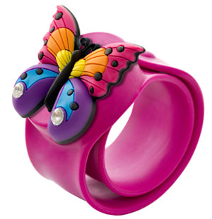
DATA IS CHILD’S PLAY /
Notes:
Kids are choosing toys, or parents on their behalf, based on the value of the data they generate – Geopalz pedometer with cloud interface where kids can compete against each other and win prizes.
Not quite conkers….

Slide 26
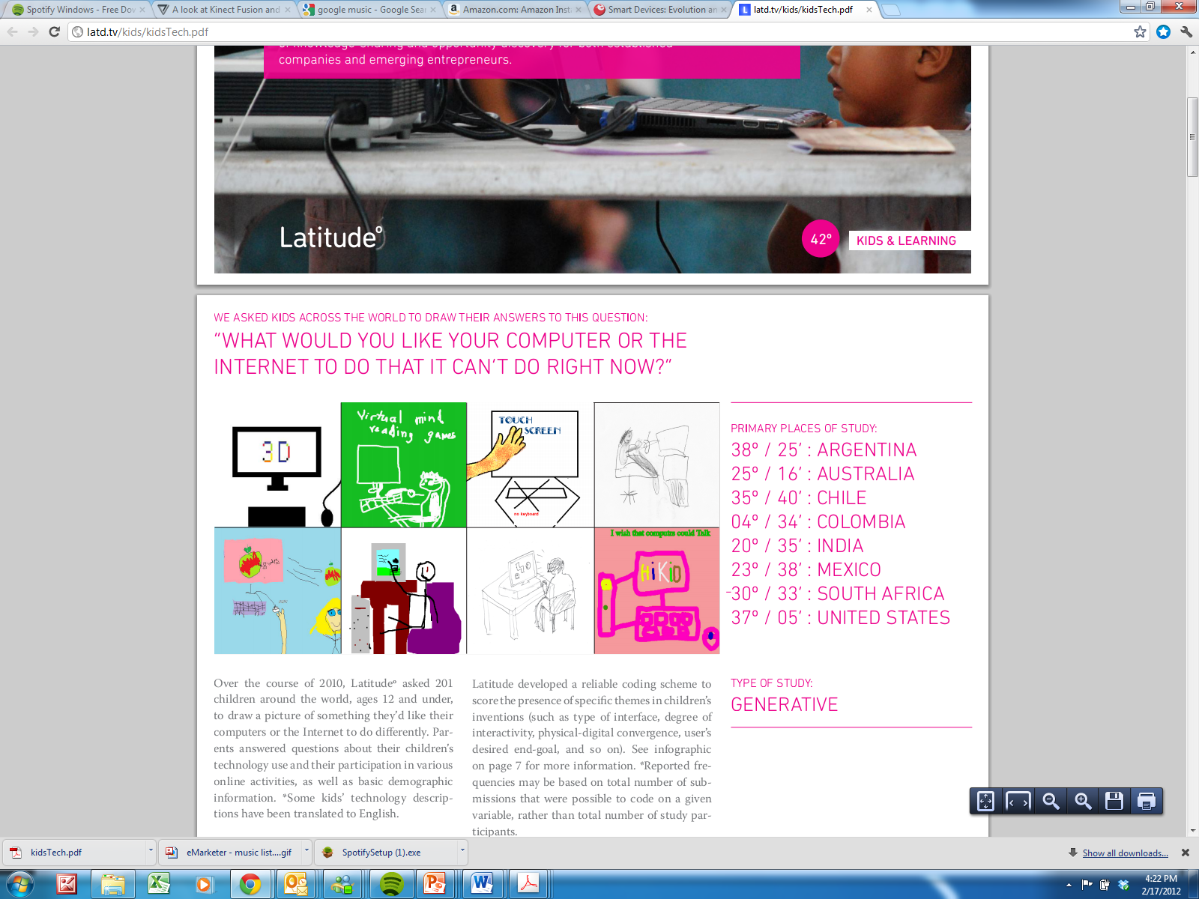
5. TECHNO-TOTS
Notes:
By definition the youth of today are the consumers of tomorrow… but we wanted to put a spotlight on today’s toddler demographic as we feel that their experience epitomizes the trends we have talked about.
Crucially, today’s toddlers don’t think there is anything the least bit odd about any of these trends – not an “inception point in computing” for them.

Slide 27

TODAY’S KIDS ARE V.I. NATIVES /
iPad is number 1 item on Christmas list for 6-12 year olds, 2010 and 2011 (Nielsen)
Notes:
http://blog.nielsen.com/nielsenwire/online_mobile/american-families-see-tablets-as-playmate-teacher-and-babysitter/
7 out of 10 kids under age of 12 are using tablets – up from 57% since last quarter
Toddlers are highlighting a new standard in computing

Slide 28
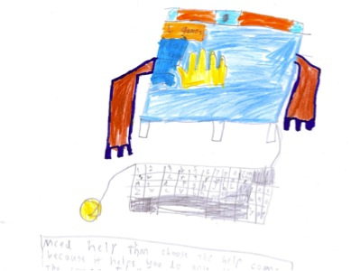
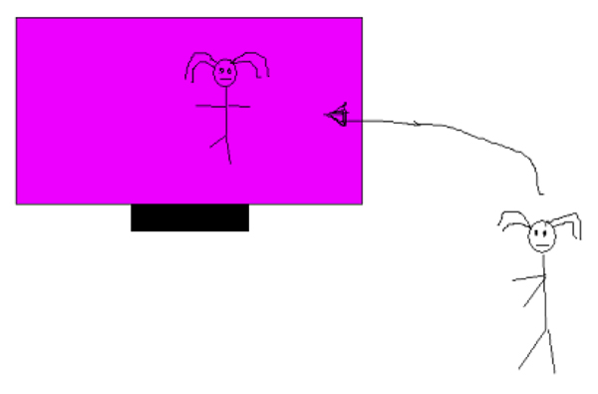
KIDS SEE DEVICE AS EXTENSION OF THEMSELVES/
“Help Computer: it knows what you are thinking and does it for you–both touch and voice controlled.” –Male, 8, Brisbane, Australia
“I’d like to go through the computer to the places that are inside it.” –Female, 4, Medellin, Colombia
“I’d like to touch the things that are in the screen — feel and move them.”
—Female, 7, Barcelona, Spain
Source: Latitude 2010 Study, KIDS 12 AND UNDER
Notes:
Research: “What would you like your computer to do that it doesn’t do now?”

Slide 29
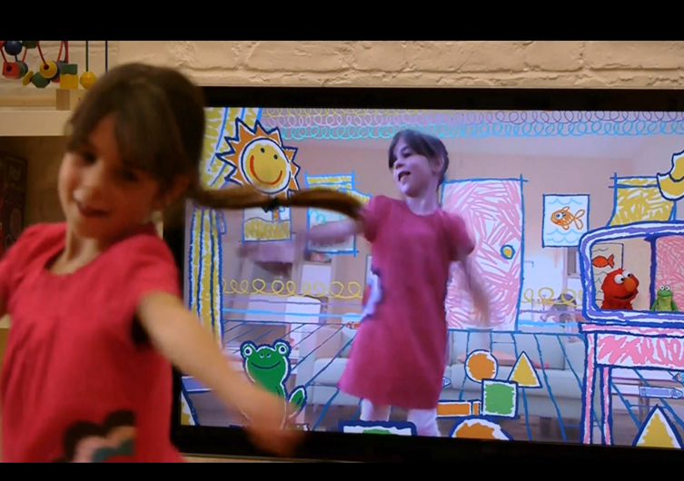
INDUSTRY SCRAMBLING TO MEET THOSE NEEDS /
Notes:
No surprise perhaps that some of the most impressive innovation is being targeted at kids.
Sesame St/XBL - where home entertainment is set to go.
Interactive, interface-less entertainment.

Slide 30
2012 TRENDS IN SUMMARY /
Realizing the connection of the physical and digital ecosystem:
-Physical products are triggering digital purchases.
-Digital delivery is being embedded into physical products.
-Widespread opportunities to move seamlessly between the digital and physical realms.
This is how consumers experience the world…..

Slide 31
THANK YOU /

